Slide 1
SS ZG 526: Distributed Computing
Distributed Computation Model, and Logical Clocks
Chittaranjan Hota
Professor, Dept. of Computer Sc. & Information Systems
BITS, Pilani Hyderabad Campus, Hyderabad
hota@hyderabad.bits-pilani.ac.in

Slide 2
A distributed program
A distributed program is composed of a set of n asynchronous processes, p1, p2, ..., pi , ..., pn.
The processes do not share a global memory and communicate solely by message passing.
The processes do not share a global clock that is instantaneously accessible to these processes.
Process executions and message transfers are asynchronous.
Birla Institute of Technology and Science, Pilani (Deemed University)

Slide 3
A model of distributed executions
Birla Institute of Technology and Science, Pilani (Deemed University)

Slide 4
Models of Communication Networks
There are several models of services provided by communication networks, namely, FIFO, Non-FIFO, and causal ordering.
Birla Institute of Technology and Science, Pilani (Deemed University)

Slide 5
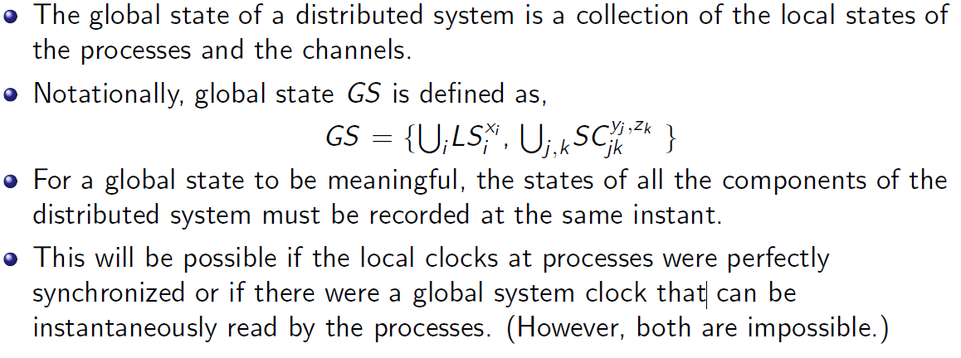
Global state of a distributed system
Birla Institute of Technology and Science, Pilani (Deemed University)

Slide 6
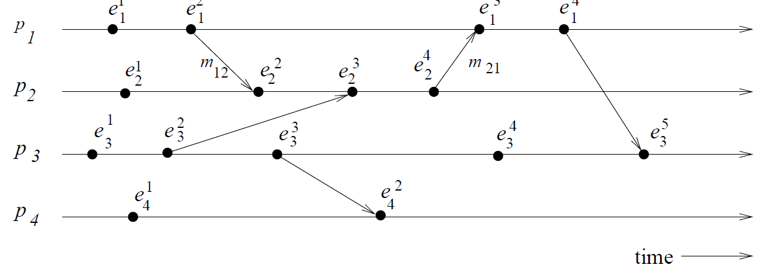
Consistent global state
Birla Institute of Technology and Science, Pilani (Deemed University)

Slide 7
Next session
Lamport’s logical clocks
Birla Institute of Technology and Science, Pilani (Deemed University)

